Slide 1
Doctor Appointment System
Presented By
Anusha Chava(GIC1221019)
NagendraBabu Gunduboina(GIC1221020)
Sudha Rani Asam(GIC1221022)
Guided By
Sandhya Singh,HCL TSS

Slide 2
Introduction
The Doctor Appointment booking system is a web application that gives a solution to the polyclinic patients.
This system manages complete booking details in a single application and in a single database.
The users will use this system to handle all the functionalities easily.
The intentions of the system are to reduce overtime pay and increase the number of patients that can be treated accurately.

Slide 3
Objective
The system aims to help the patients to make appointments online through the internet and track their records through it.
Doctor Appointment Booking System has been facing problems due to its paper-based appointment system. With the increase in the number of patients visiting, it has become difficult to manage the appointment system manually.

Slide 4
List of Modules
Admin
Doctor
Patient

Slide 5
Admin
Admin module allows system administrator to set up back-end of the system and perform basic system configuration, mainly definition of predefined drop-down fields, definition of classes time schedule, etc.
Admin can also set up overall system security settings such as required password strength, inactive session time out, inactive accounts lock out, password reset period, etc. Important part of security is audit log – any changes in the system are logged here – so it’s easy to check who changed/removed what, at what time, what was the original value and what is the new value set.

Slide 6
Doctor
Doctor Management System allows registering the doctors, working in a hospital as well as their clinic details. It helps in the duty management of doctors and updates them complete appointment details with a patient health history.

Slide 7
Patient
Patients will be the main users. The system is also designed to be user-friendly. Patients can view their appointment history and doctor’s details and timings. And also can make appointments online.

Slide 8
Software Interface
Front end: HTML,CSS,JavaScript
Language: Java Spring Boot
Back End: Oracle 11g

Slide 9
Hardware Interface
Processor: Intel Pentium4 2.00GHz or above
Memory: 512MB
Hard Disk Drive: 40MB or above

Slide 10
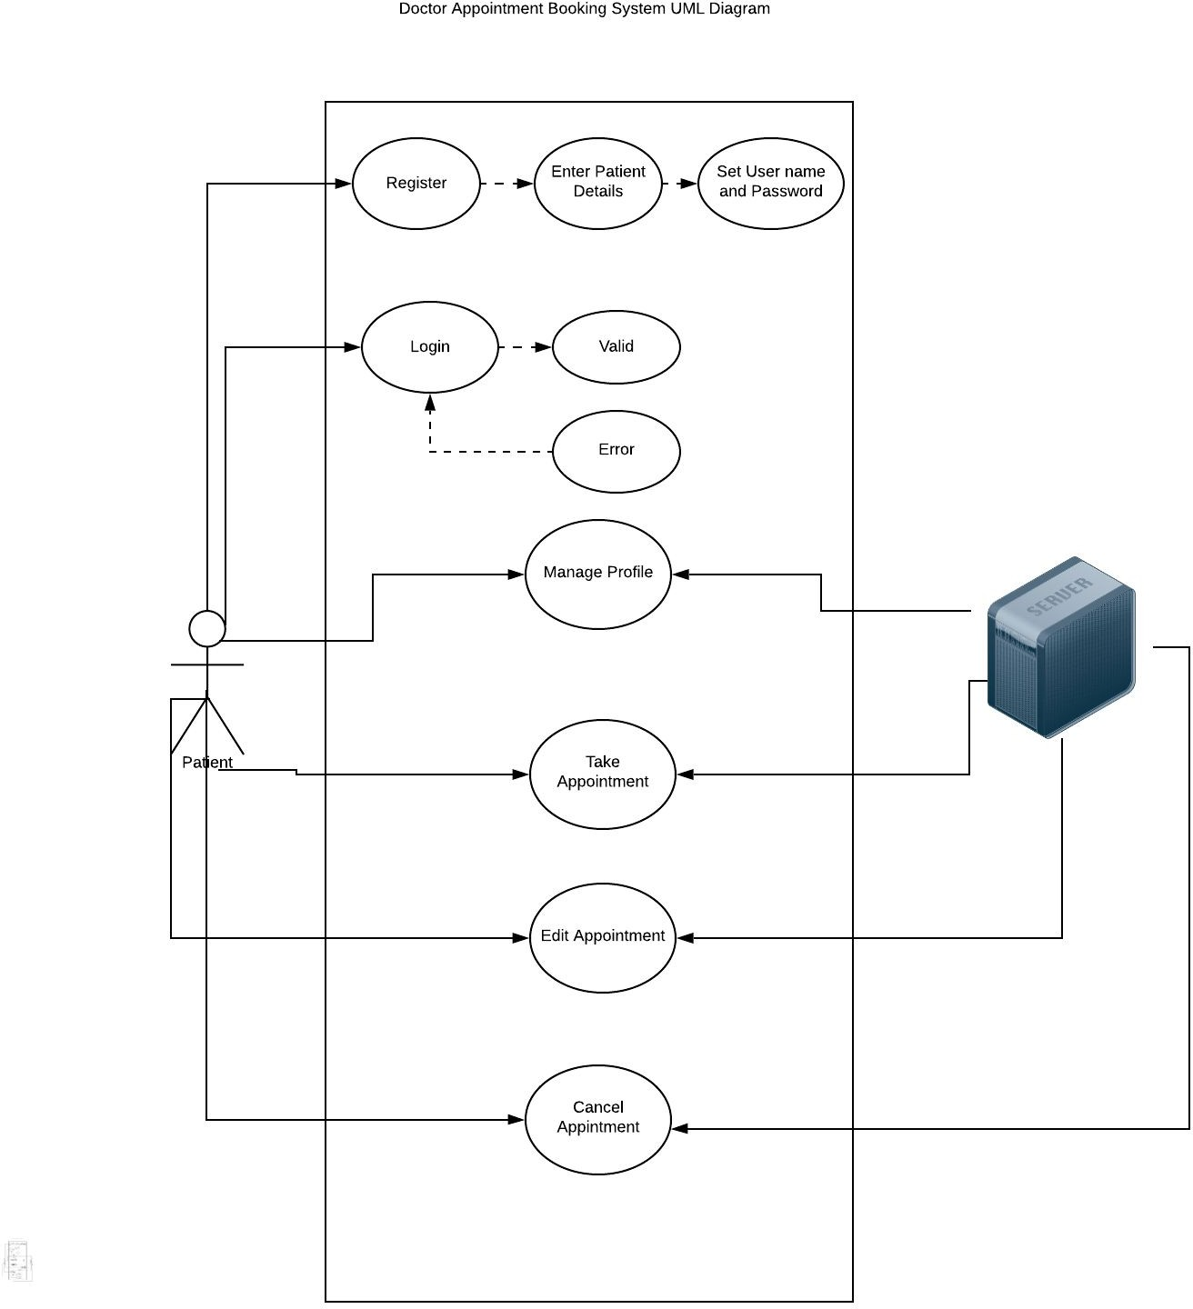
UML Diagrams
UseCase Diagram

Slide 11
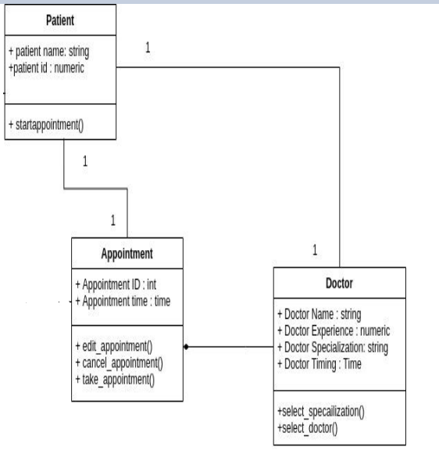
Class Diagram

Slide 12
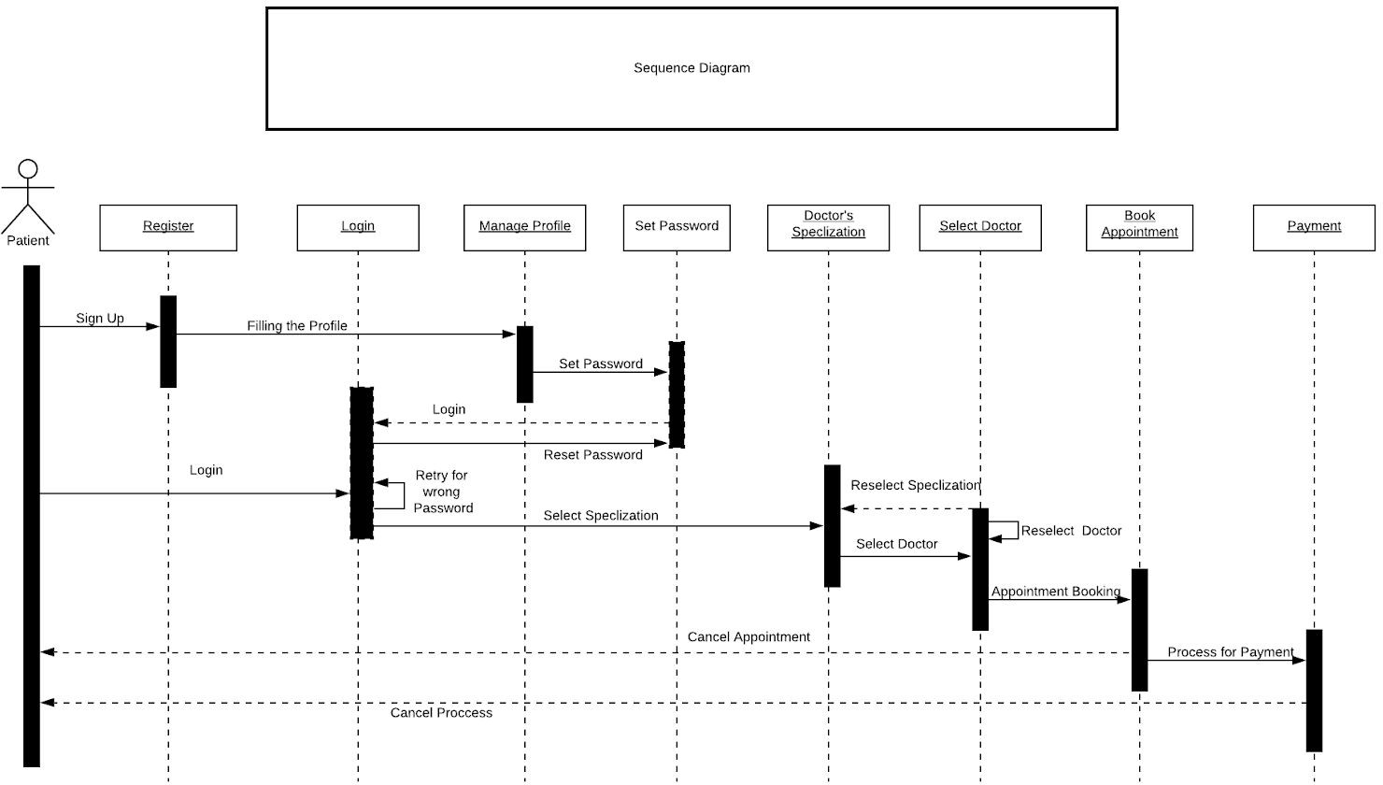
Sequence Diagram

Slide 13
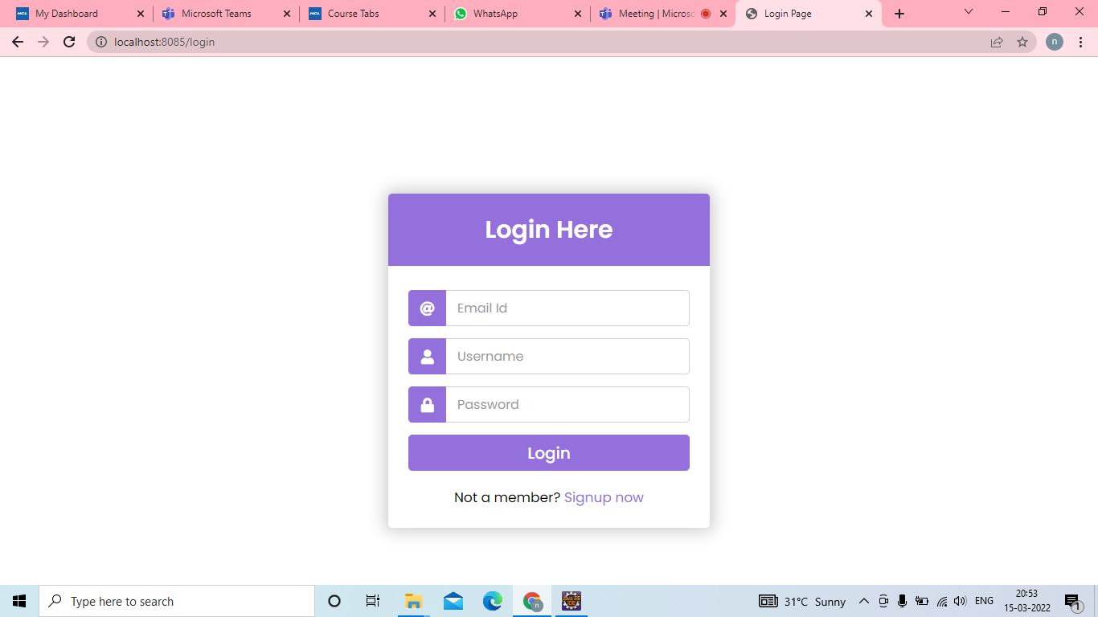
Login Page

Slide 14
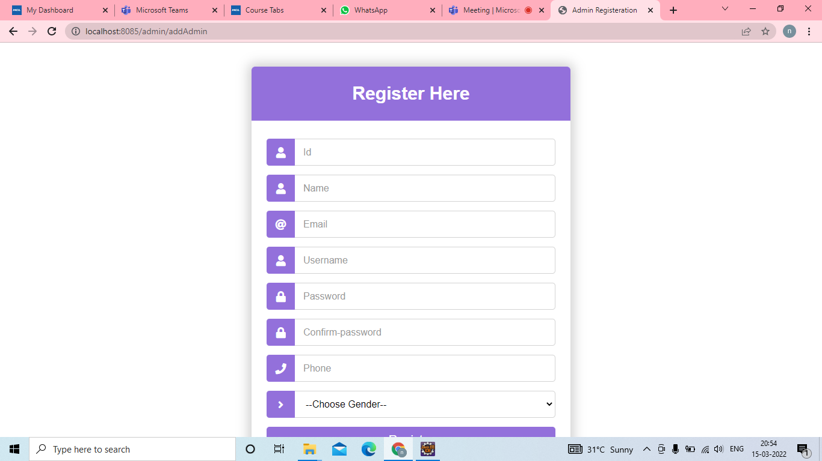
Admin Registration Page

Slide 15
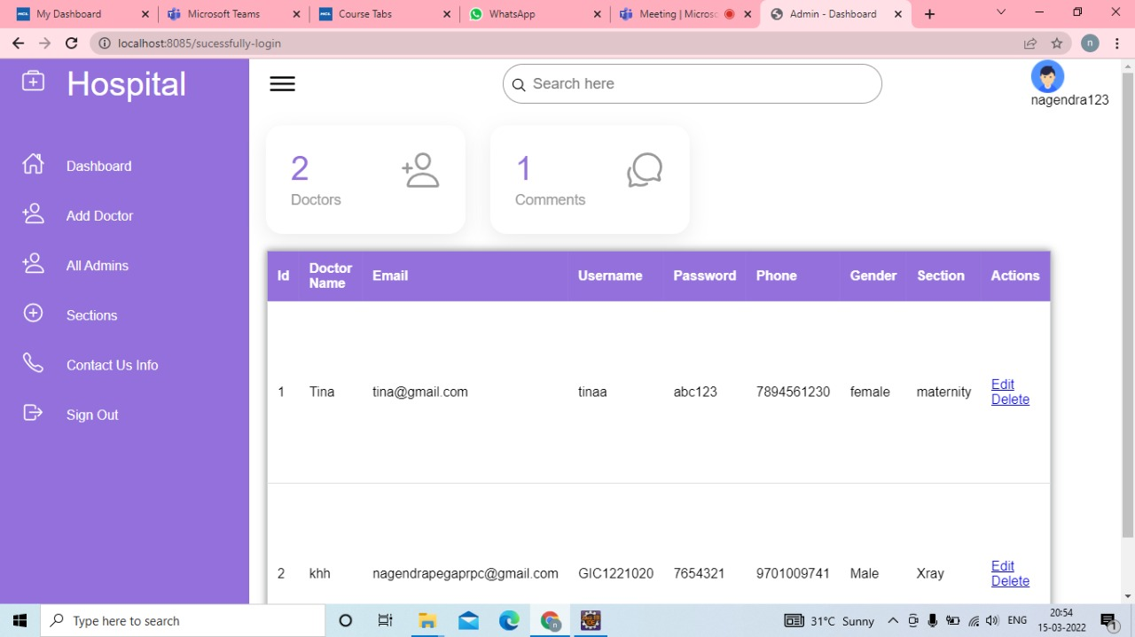
Main Page

Slide 16
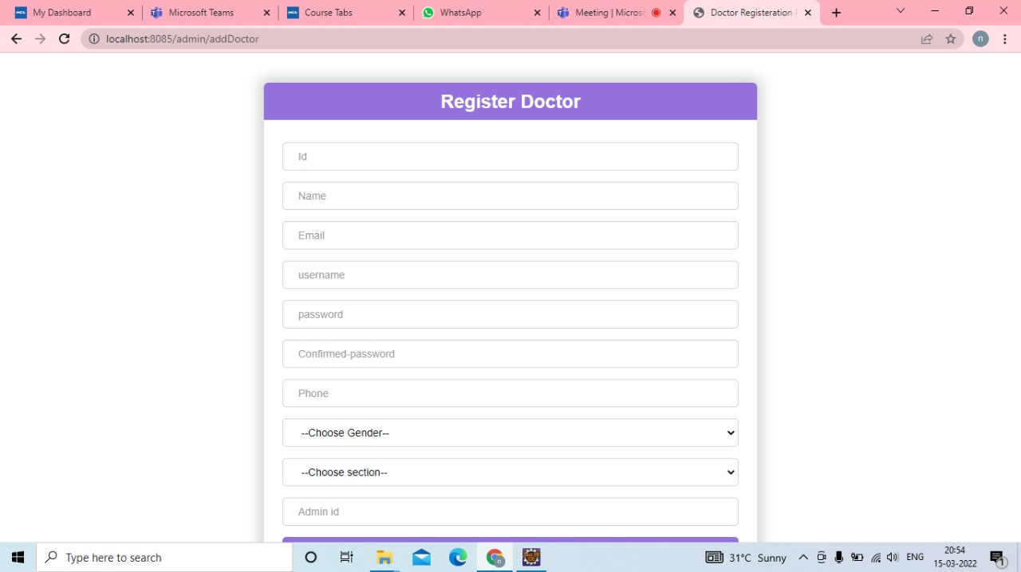
Doctor Registration Page

Slide 17
Doctors List

Slide 18
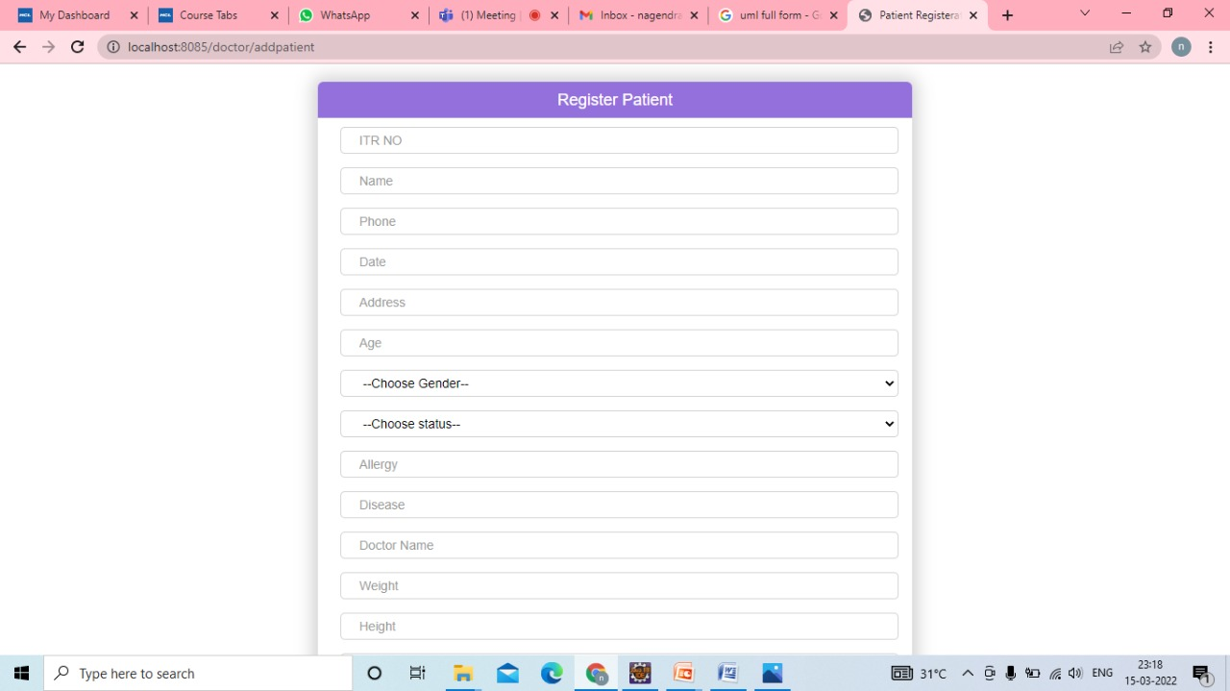
Patient Registration Page

Slide 19
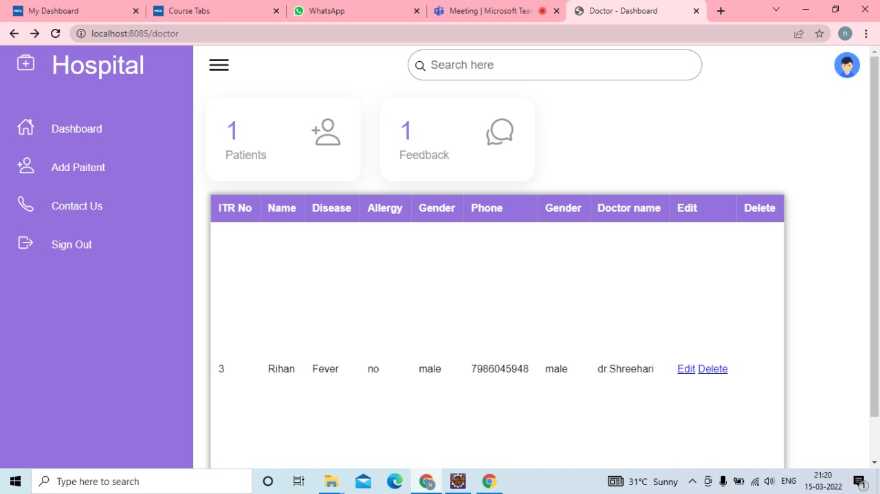
Patients List

Slide 20
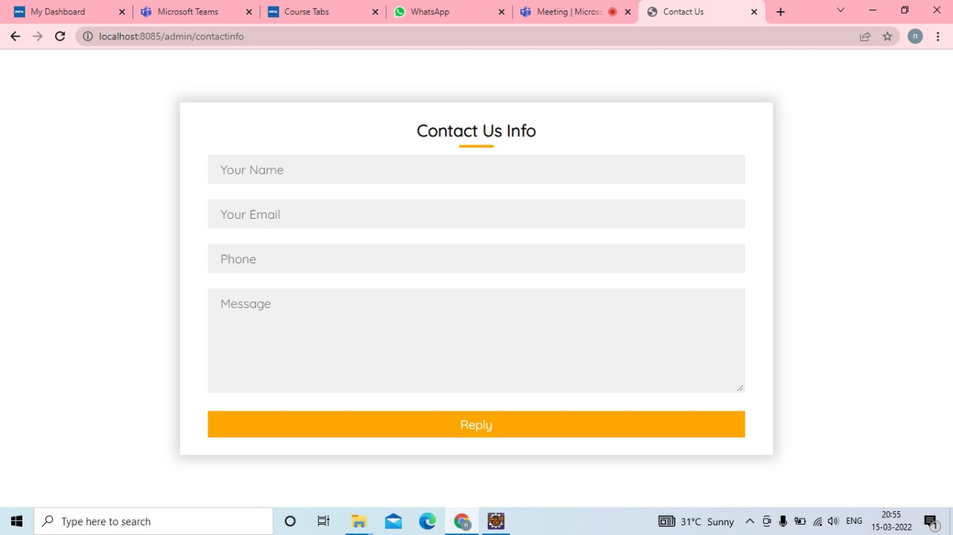
Contact Us Page

Slide 21
Features
Multiple Locations and multiple doctors.
24*7 booking: Anytime Anywhere.
Access appointments on your computer, laptop and mobile phone.
Organise your schedule better.

Slide 22
Conclusion
Patients are increasingly looking at convenient ways to book appointments. They prefer to use options available on their mobile or laptop to book appointments.
The pandemic has made sure that digital modes are embraced even by sections of society that was either hesitant earlier or had limited access to the internet or such tools. Patients are also likely to be more welcoming of these tools.

Slide 23
THANK YOU

